Slide 1

Intelligent Factory
2019/2020
Agents and distributed artificial intelligence
Group 21:
Andrea Díaz Henry C. - up201901577@fe.up.pt
Helena Montenegro - up201604184@fe.up.pt
Juliana Marques - up201605568@fe.up.pt

Slide 2
Problem Description
Our project consists of a factory that has machines and receives orders.
An order has a list of tasks that the machines need to do in order to produce a product. There is a need to allocate machines capable of answering to the orders, while minimizing the time needed for each order’s production.
Each machine has a role which only makes it able to perform a specific task. The average time per task of a machine can be different for machines with the same role. The machines can lie about the time they take to fulfill a task. For that, there are two factors taken into account: proactivity and honesty. Proactive machines lie in order to decrease their execution time and machines with low proactivity value lie in order to increase it.
Each order has a certain number of credits which are awarded to the machines that complete one of its tasks. When an order sees that the machines with best finish time have times close to each other, it tries to negotiate with them by giving more credits so that the machines decrease their execution time.
1

Slide 3
Global Schema: Agents
Order - has tasks that need to be done and chooses the machines that do the tasks, with the objective of minimizing the time needed to fulfil each task.
Machine - allocates time to do tasks from orders and proposes expected finish times to do a task. It has personality factors that define how interested the machine is in doing a task (proactivity and honesty factors). A machine can work on tasks from many different orders.
Order 1
Order 2
Interactions
Machine 1
Machine 2
Machine 3
2

Slide 4
Interaction and Communication Protocols
We used the FIPE-Iterated-Contract-Net Protocol to establish communication between an order and machines. Each machine is organized by its role in a Directory Facilitator.
Order - Initiator
Machine - Responder
1) For the first task, the order will send an arrival message which contains the initial time at which the task can be started and the credits the machine receives.
3) The order collects all answers. If it’s not satisfied, it can try to negotiate with the machines that gave the best results by increasing the credits it offers. Otherwise, it accepts the best machine and rejects all others.
5) The order redoes the protocol for the following tasks or marks itself as finished if there are no more tasks.
2) The machine answers with the time they expect to finish the task, considering the credits that the order offers, its average time and its proactivity and honesty factors.
4) Upon receiving a REJECT_PROPOSAL message, the machine ends the protocol.
4) Upon receiving an ACCEPT_PROPOSAL message, the machine saves the order’s allocation and its credits. It sends a final message confirming the allocation.
CFP
Propose
CFP
Reject
Accept
Inform
3

Slide 5
Strategies: Order
The order has the following decision processes:
To choose whether or not to negotiate with the machines in order to improve the expected finish time for a task. The order tries to negotiate up to three times, if there is more than one machine trying to get the task and if the best values of expected finish times received are close to each other, which means that there are at least two machines competing for the task and that either one still has a change to get it.
To choose the machine that does the task. The order chooses the machine that proposed the best expected finish time.
4

Slide 6
Strategies: Machine
The machine has the following decision processes:
To choose whether or not to lie. The machine lies based on its honesty factor.
To choose how much to increase or decrease its execution time, when it lies. The machine increases its execution time if its proactivity factor is higher than 0.5 and decreases if its lower than that. The increment /decrement considers the machine’s proactivity factor.
To choose how much to decrease its execution time when the credits to be received increase. The machine improves its execution time on the negotiation process according to how much more the credits that the order offers are, when compared to the average of credits it has received per task so far.
5

Slide 7
Used Software and Compilation process
We developed the project on Eclipse with Jade. For the project to compile, it needs to have the jade library. There are two ways to run the project:
Run the class factory/IntelligentFactory with no arguments: a menu will appear that will show some examples to run the project with different initial values.
Run the class factory/IntelligentFactory with the following arguments:
<number of machines> <number of orders> <minimum number of tasks per order> <maximum number of tasks per order> <minimum average time per machine> <maximum average time per machine> <minimum number of credits> <maximum number of credits>
6

Slide 8
Experiments
At first, we ran the factory with only one type of task, with 100 orders and 5 machines, in order to have more accurate results by having a bigger population. This made it possible to compare first the machines with the same tasks. Afterwards we added more tasks and made the system more complex.
Results:
If the average time of a machine is significantly better than the orders, then that machine will get the task.
When the average time is similar, the machines that get more orders are proactive (proactivity ratio > 0.5), and liars (honesty factor < 0.5).
The machines that get less orders assigned are lazy (proactivity ratio < 0.5) and liars.
The credits the machines receive are proportional to the number of tasks of orders done.
When the number of tasks per order increases, there is also an increase in the average time per order, as well as the last finish time.
The more tasks there are, the bigger the chance of some orders being unfulfilled.
The average of credits received is bigger if there are less unfulfilled orders and when there are less machines in the system.
7

Slide 9
Result Analysis
The factors that affect which machine gets more orders allocated the following:
Average time -The average time is used to calculate the execution time for a machine, so if it’s significantly better than the orders, even if the orders lie and improve their execution time, the machine with the best average time might still win.
Honesty and Proactivity factors - Proactive machines lie in order to improve their execution time and lazy machines lie in other to decrease it. When the machines have similar average times, these factors act as a tiebreaker. When a machine is proactive and a liar, its chances of getting an order are bigger. When a machine is lazy and a liar, its changes of getting an order are lower.
Credits received by the order - The credits that the machine receives are taken into consideration in a negotiation process. The machines compare the credits that the order offers with the average of credits received until that point and decide by how much to improve their execution time in order to get that order.
8

Slide 10
Result Analysis
When there are more tasks per order, the average time needed to complete an order gets bigger, as well as the last finish time. This happens because the tasks in an order are sequential and as there are more orders in the system, for the same number of machines, the orders need to wait for a machine to be available before doing a task.
The number of unfulfilled orders depends on the number of machines there are in the system. If there are no machines to fulfil a task, then all orders that have the task won’t be fulfilled.
The average of credits received per machine depends on the number of machines in the system, because if there are less machines, there are more orders allocated to each machine, which makes the machines receive more credits. It is also dependant on the number of orders, since more orders means more credits to give. When there are more tasks, for the same number of orders and machines, there are also more credits, since the credits are given per task, so that also results in an increase on the average of credits received.
9

Slide 11
Conclusions
This project was a successful learning experience where we understood how to implement FIPA protocols of communication between agents, in specific the contract net protocol as well as its iterated version. We also developed our capacity to develop strategies for the agents to make decisions and see how the strategies influence the end results. We didn’t try out other tools like Repast on the project and we didn’t implement Artificial Intelligence strategies like Reinforcement Learning, but overall, we’re satisfied with how our project turned out.
In the next project, we intend to analyse in more detail how the machines are chosen by the orders considering their proactivity and honesty factors, as well as their average time and their capacity to negotiate. In general we also want to further analyse how the average time needed to fulfil an order changes with different initial values and other aspects related to the credits: how the remaining credits per order change according to different inputs; how the average of credits received per machine changes and how the average of credits received per order in a machine changes.
10

Slide 12
Additional information
Intelligent Factory

Slide 13
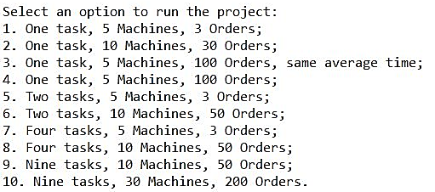
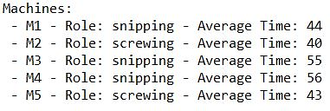

Example of Execution
A very simple example of execution is the option 5 of the initial menu when the project is run without arguments. It only has 3 orders, 5 machines and 2 available tasks.
Initially, the console shows how the orders and machines were initialized:
11

Slide 14
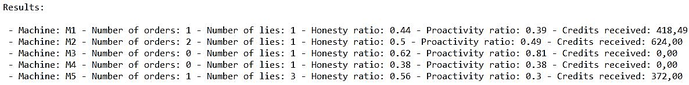
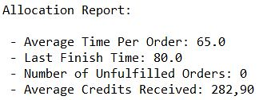
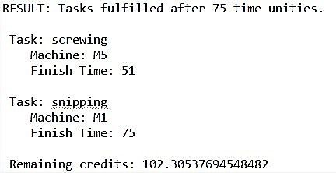
Example of Execution
Then the console shows the results of the execution, by showing how many orders were allocated to each machine and how many credits each machine received (the honesty and proactivity ratios are shown only to help interpret the results):
It also shows the general allocation report for the execution:
On the folder messages, on each order, we can see the results of the allocation, which has information about which machine was allocated for each task and their finish time, as well as the time that the order finished being done as well as the remaining extra credits:
12

Slide 15
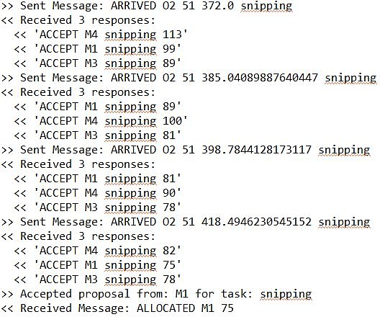
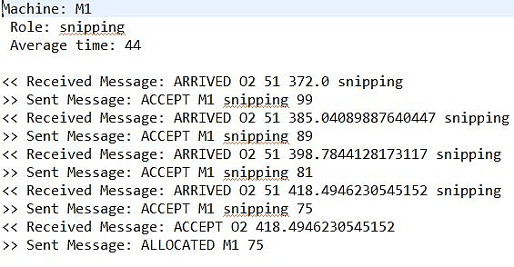
Example of Execution
On the folder messages, there are text files related to the execution of each agent, on which we can see the messages exchanged between the agents. Here is an example of the negotiation process:
Order 02
Machine M1
13

Slide 16
Implemented Classes
Package factory:
IntelligentFactory - The class that generates the agents with random initial values that consider the arguments received in the constructor.
Package agents:
Order - The agent Order, which has its setup and all the logic for the decision making process. It has an id, a list of tasks, the number of credits it gives per task as well as extra credits for negotiation, and it saves the machines that do each task and their finish time.
Machine - The agent Machine, which has its setup and all the logic for the decision making process. It has an id, a role, a proactivity factor, an honesty factor, an average time and it saves the orders it fulfils and the respective time slot.
14

Slide 17
Implemented Classes
Package utils:
TimeSlot - The utility class that represents a time slot, with an initial time, final time and an order id.
Package behaviours:
OrderInitiator - The behaviour of type ContractNetInitiator that receives and send the messages according to the protocol FIPA-Iterated-Contract-Net. It is added to the Order agent for each task it has.
MachineResponderDispatcher - The behaviour of type SSResponderDispatcher that creates the responder needed for the protocol, which is added to the Machine.
MachineResponderToOrder - The behaviour of type SSIteratedContractNetResponder that receives messages from the initiator and sends answers, according to the used protocol.
15

Slide 18
Messages Exchanged
Order to Machine:
Arrival message that sends the order’s id, the time where the machine can start to do the task, the credits it received and the task. It is also used for negotiation:
ARRIVED <order_id> <initial_time> <credits_given> <task>
Message to accept machine’s proposal, which sends the order’s id and the credits given:
ACCEPT <order_id> <credits_given>
Message to reject machine’s proposal, which only sends the order’s id:
REJECT <order_id>
16

Slide 19
Messages Exchanged
Machine to Order:
Proposal message that sends the machine’s id, its role and the time when the machine expects to finish the time:
ACCEPT <machine_id> <role> <expected_finish_time>
Confirmation message to confirm that the order was successfully allocated. It sends the machine’s id and the expected finish time:
ALLOCATED <machine_id> <expected_finish_time>
17

